Slide 1




March 12, 2026

Slide 2

Announcements
Class Next Week: Downstairs
With new faces
Scrutiny Sign In
Easter Vigil Mass- All are Invited!

Slide 3

EUCHARIST

Slide 4

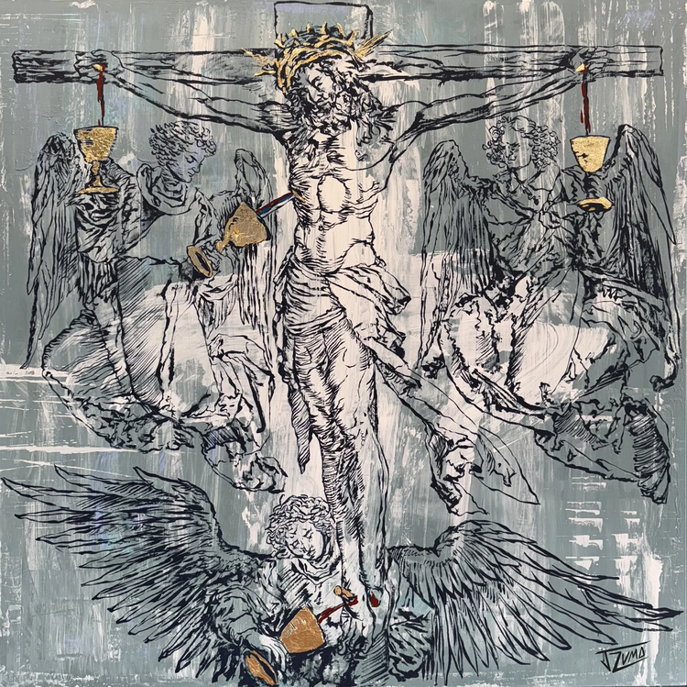
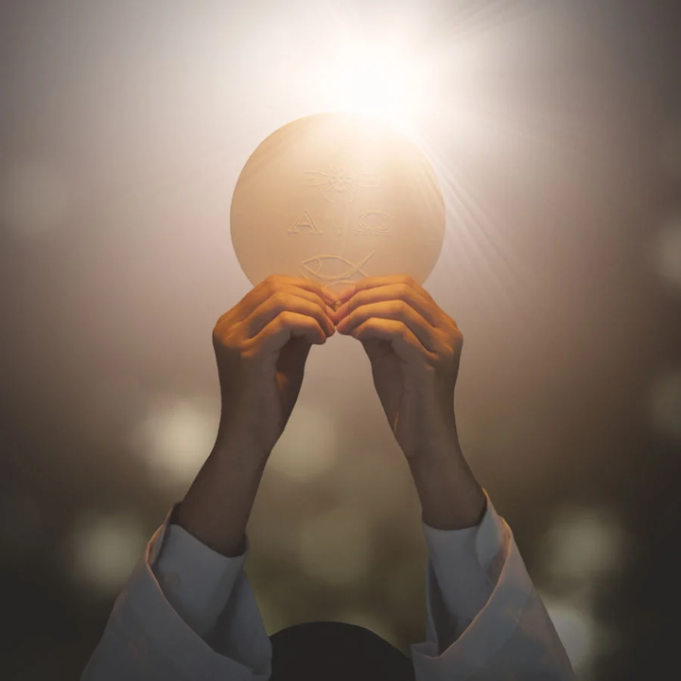
What is the Eucharist?
Body, Blood, Soul, and Divinity—under the appearances of bread and wine
Sacrifice and a sacrament
Source and Summit of the Christian life

Slide 5

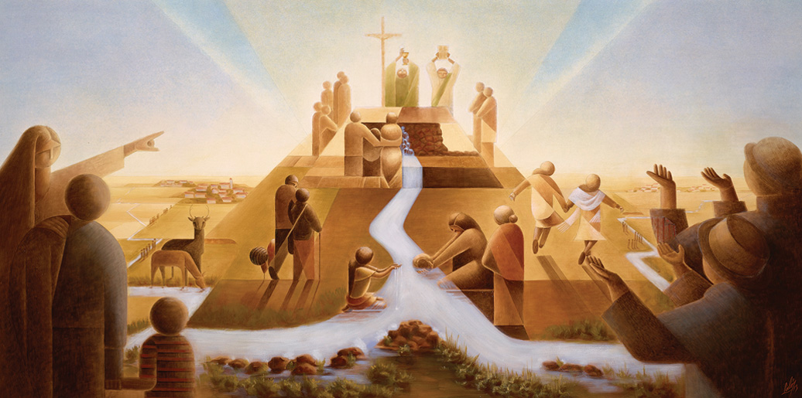
Source and Summit
SOURCE: Every grace flows from Christ’s sacrifice made present in the Eucharist.
SUMMIT: participation in the Eucharist is the highest act of worship we can offer to God.
We receive not merely grace but the Author of grace Himself.
We receive not merely grace but the Author of grace Himself.

Slide 6
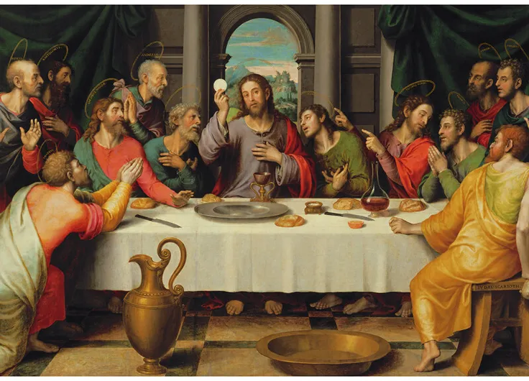
Institution of the Eucharist
The Last Supper
During the meal, He took bread and wine and said:
“This is my Body…
This is my Blood.”
He then commanded the apostles: “Do this in memory of me.”
By these words, Jesus established both the Eucharist and the priesthood.

Slide 7

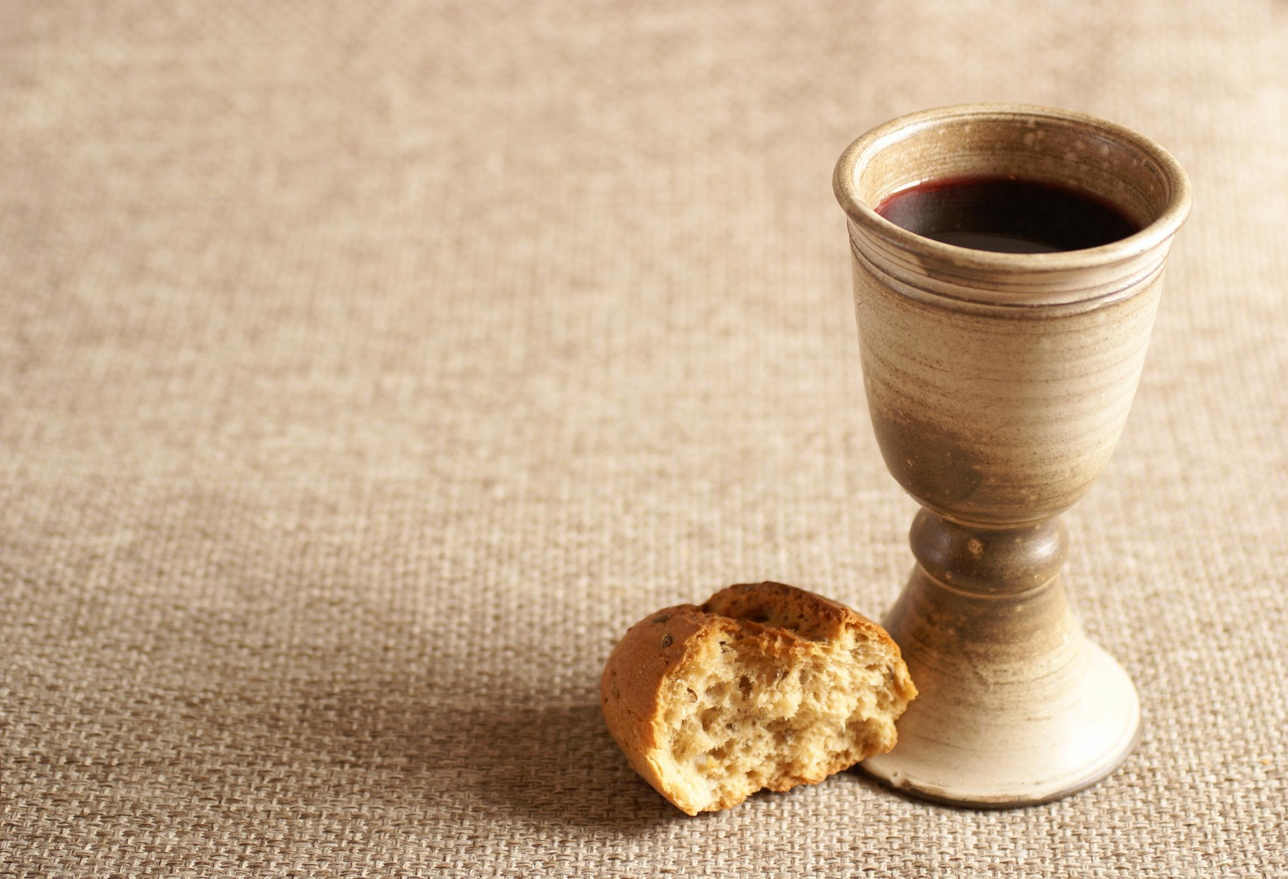
Bread and Wine
Ordinary elements of daily life in the ancient world.
They symbolize nourishment
and joy.
Christ used visible elements so that the sacrament could be perceived by the senses, even though the deeper reality is supernatural.

Slide 8

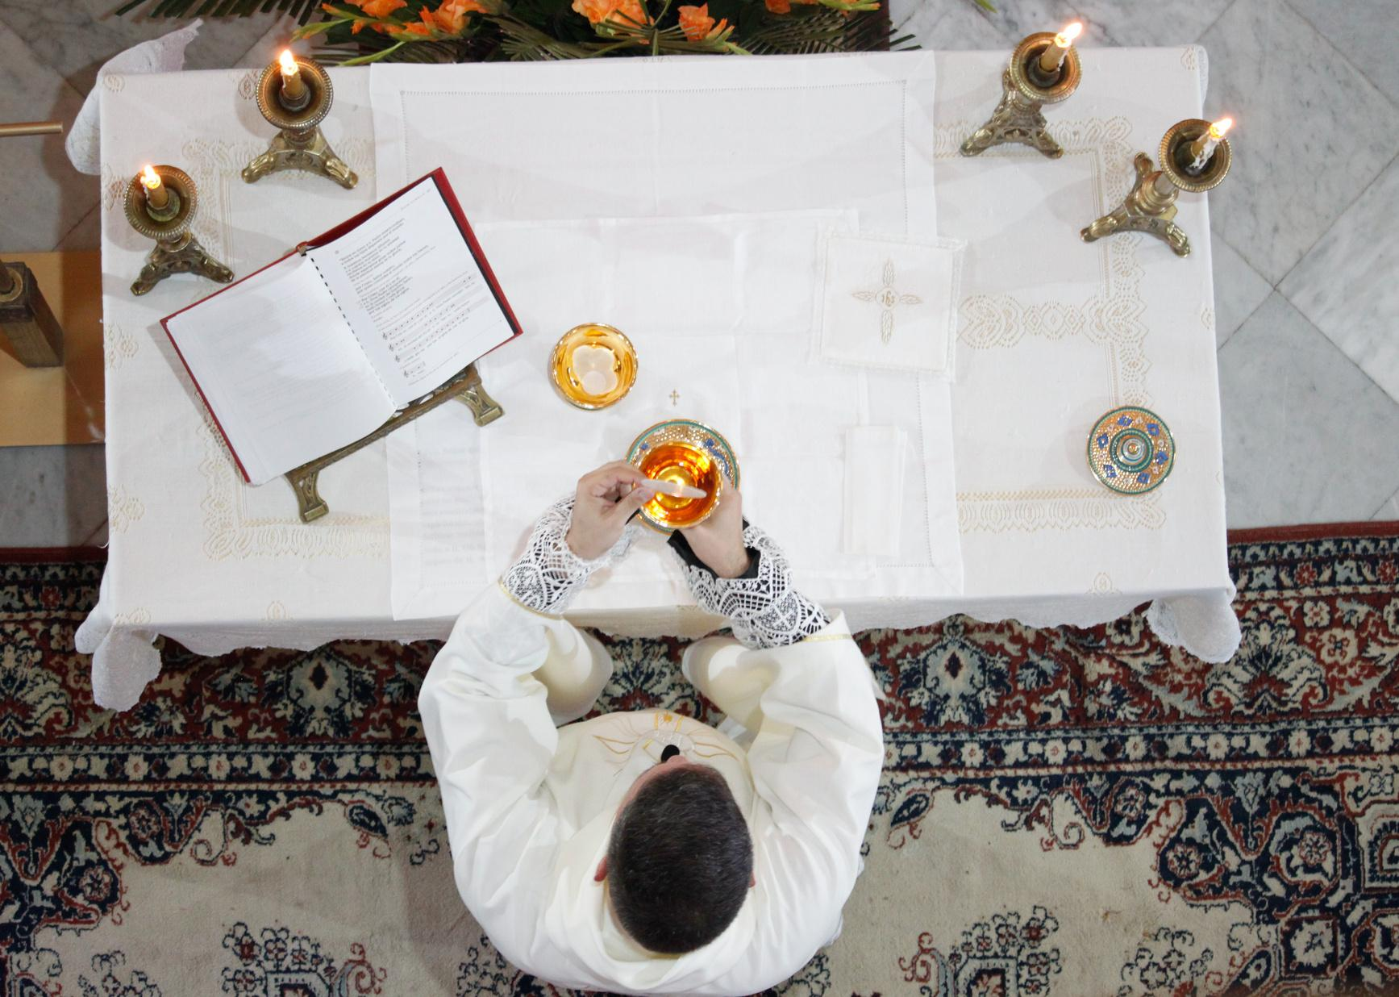
The Consecration
TRANSUBSTANTIATION:
The substance of the bread and wine becomes the Body and Blood of Christ, even though the appearances of bread and wine remain.

Slide 9
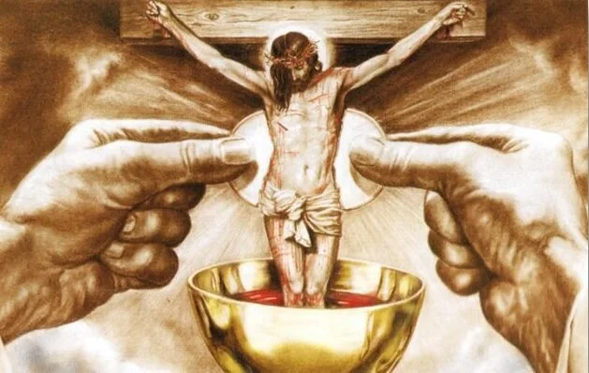
Substance and Appearance
The substance becomes the Body and Blood of Christ.
The appearances remain those of bread and wine.

Slide 10
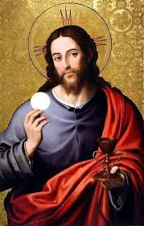
Jesus is Fully Present
Jesus is present whole and entire in each of the Eucharistic species.
Christ is fully present in the host.
Christ is fully present in the chalice.
Even a small fragment contains the whole Christ.

Slide 11

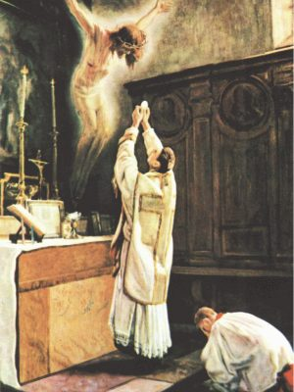
The Eucharist is a Sacrifice
The Eucharist is the same sacrifice as Christ’s sacrifice on the Cross.
Made present in a sacramental and unbloody manner.
The Mass does not repeat Christ’s sacrifice but re-presents it

Slide 12
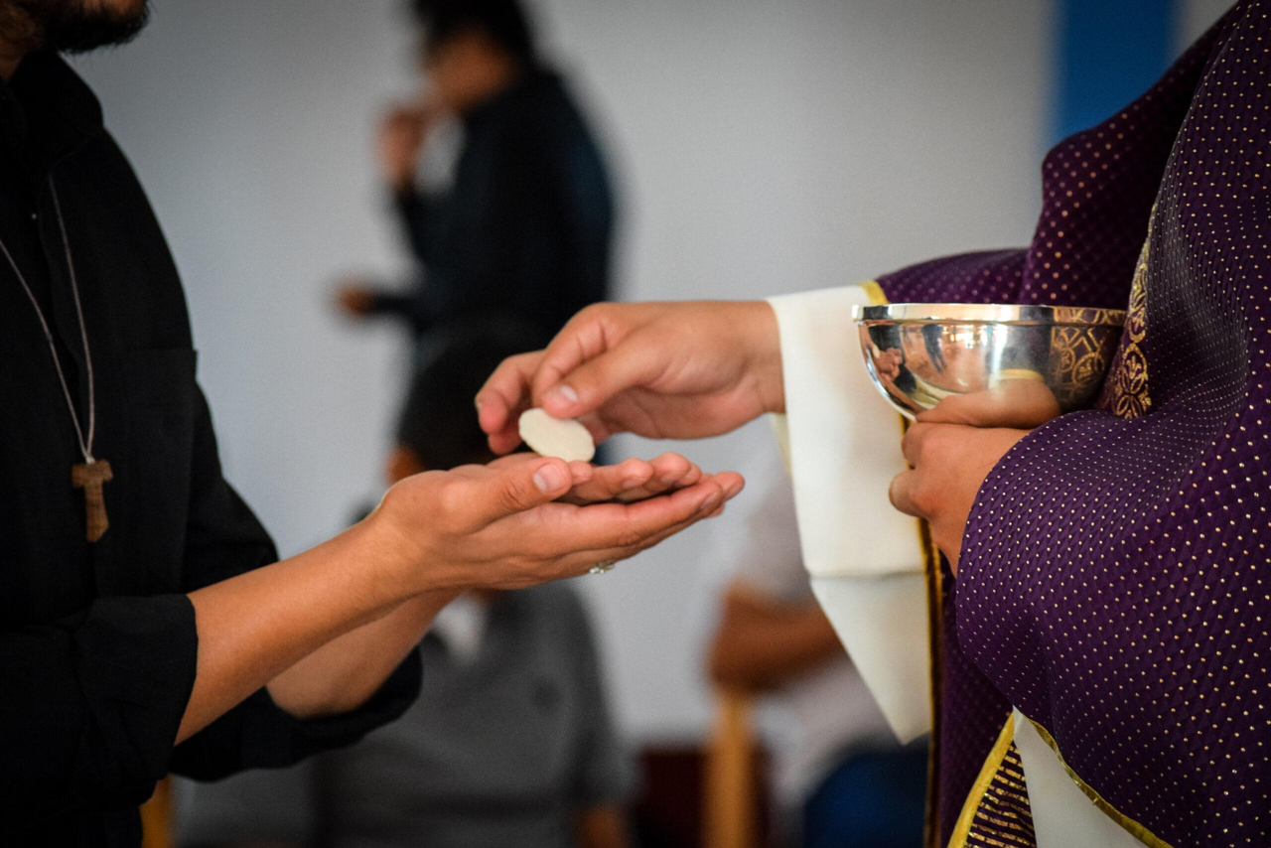
Holy Communion
Strengthens charity
Forgives venial sins
Deepens union with the Church
Nourishes the spiritual life
Spiritual food for the soul, just as ordinary food nourishes the body

Slide 13

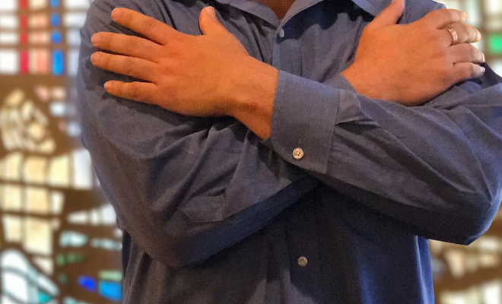
Conditions for receiving Holy Communion
Be in a state of grace (free from mortal sin)
Believe in the Real Presence
Observe the Eucharistic fast (usually one hour before Communion)

Slide 14
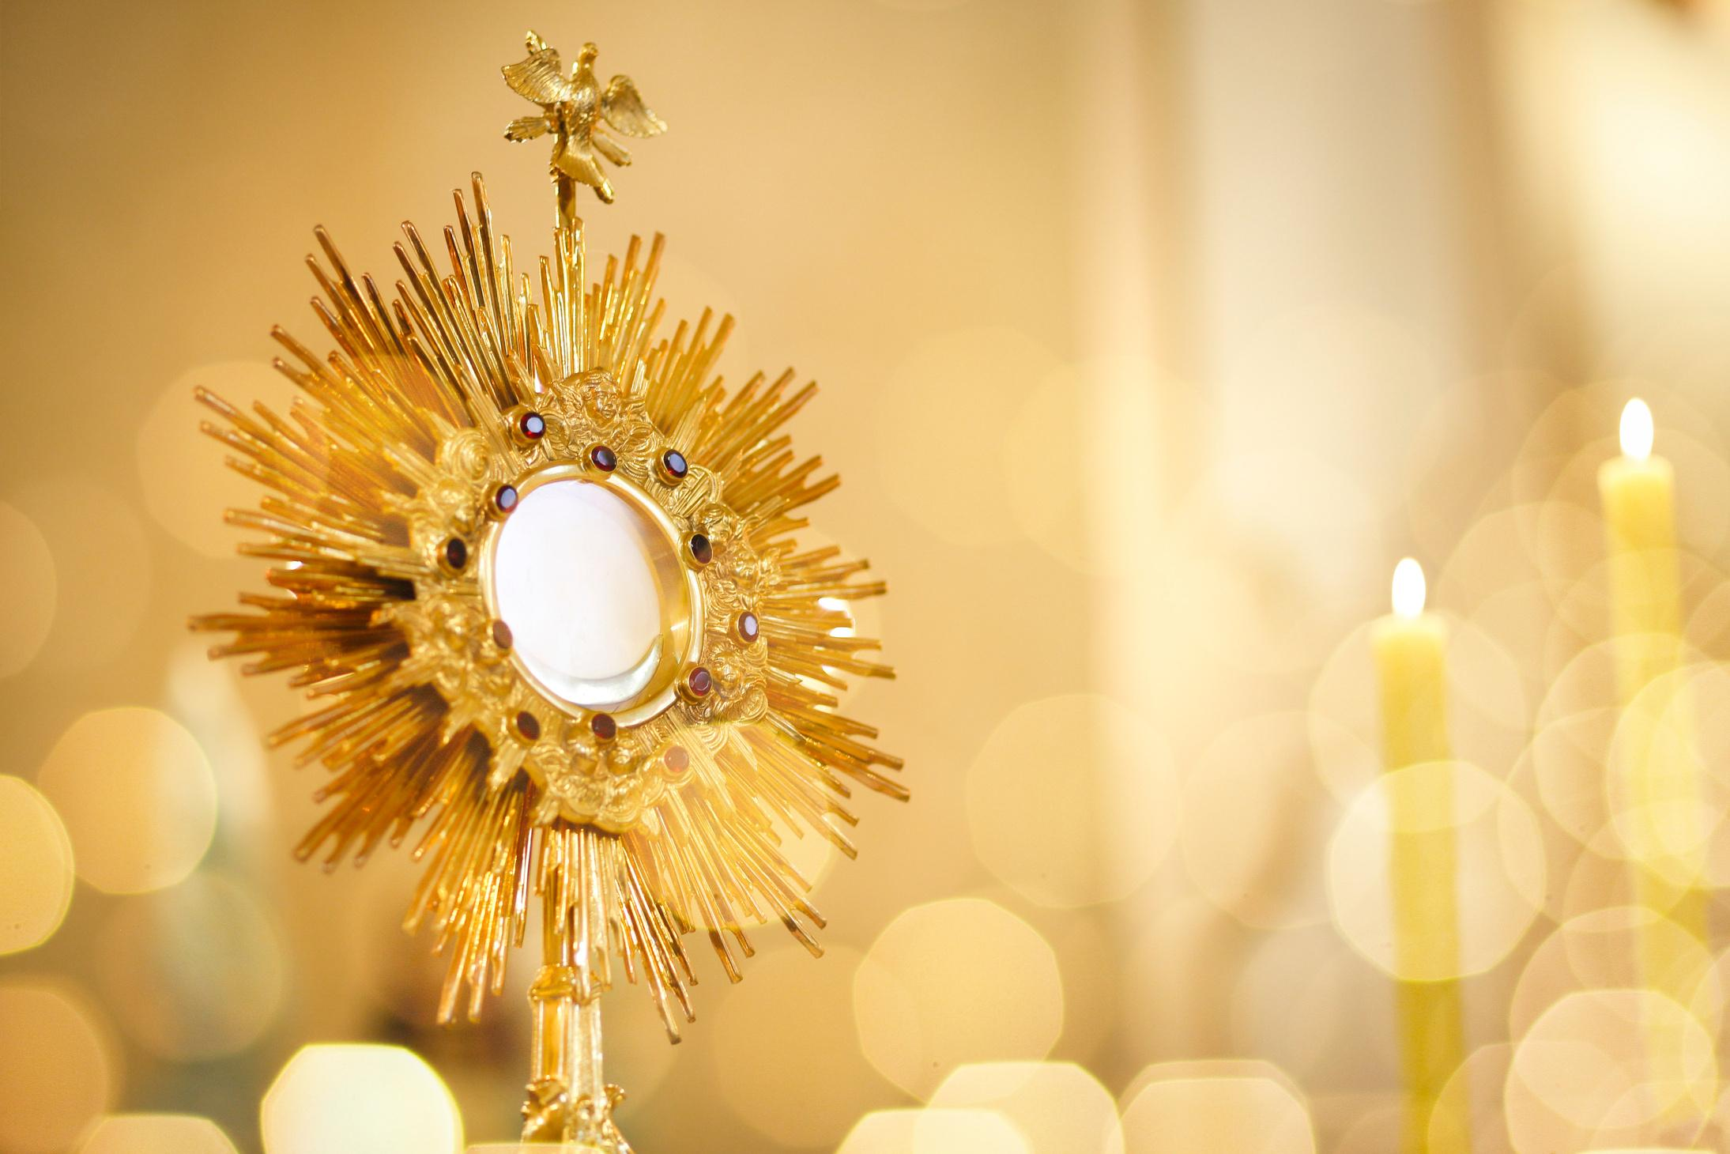
Eucharistic Adoration
Christ remains present in the consecrated hosts reserved in the tabernacle.
Adoration expresses the Church’s faith that Christ is truly present in the Eucharist even outside the celebration of Mass.

Slide 15
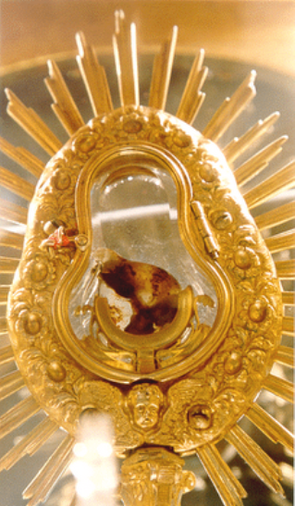
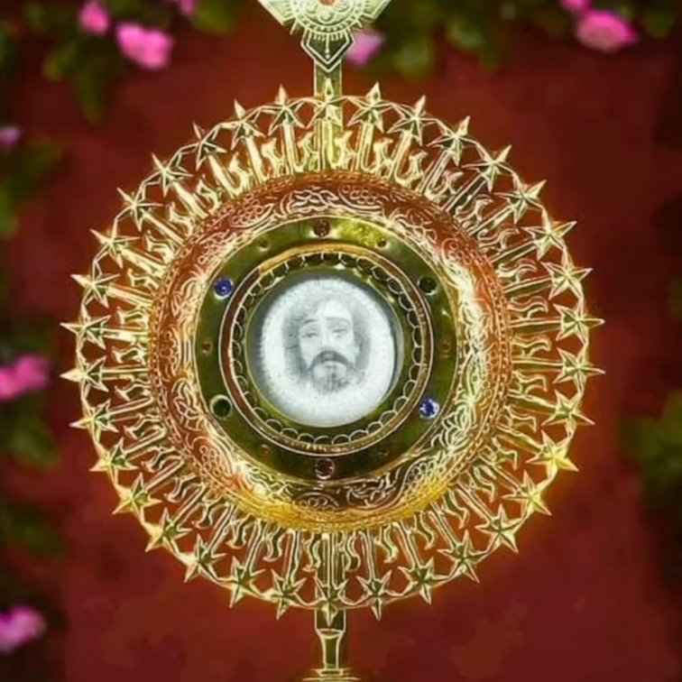
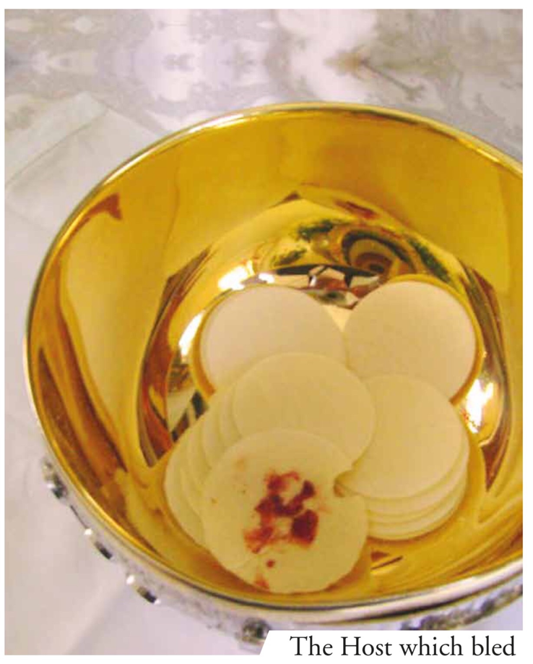
Mystery of Faith
Requires trust in the words of Christ and the teaching authority of the Church.

Slide 16
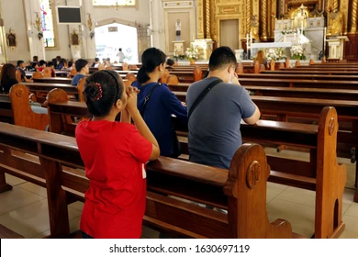
Prepare and Respond
Prayer before Mass
Repentance for sins
Attentiveness during the liturgy
Gratitude after receiving Communion
Spend time in thanksgiving after Communion because this is the moment when Christ is sacramentally present within us.
Faith
Reverence
Gratitude
Love
By receiving Christ, we are also sent to bring His love into the world.

Slide 17
Discussion Questions
What does it mean to you that Jesus is truly present in the Eucharist?
Why do you think Jesus chose to remain with us in this sacrament?
How does receiving Communion strengthen your relationship with Christ?
What practices can help us prepare more reverently for the Eucharist

Slide 18
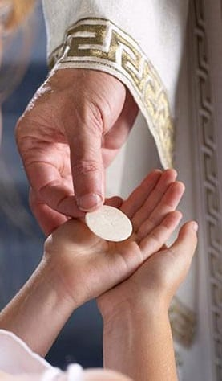
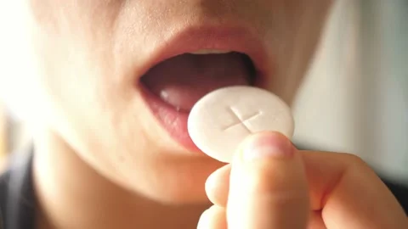
Receiving the Eucharist
RECEIVING ON THE HAND
RECEIVING ON THE TONGUE

Slide 19








Receiving Eucharist
Approach with hands in Praying Posture
Bow
Look at the host or chalice
Receive:
“The Body/
Blood of Christ”
“AMEN!”
Return to your seat to kneel and pray.

Slide 20

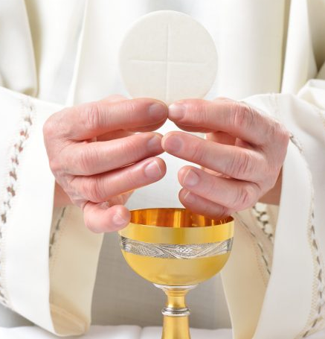
Act of Spiritual Communion
My Jesus, I believe that You are present in the Most Holy Sacrament. I love You above all things, and I desire to receive You into my soul. Since I cannot at this moment receive You sacramentally, come at least spiritually into my heart. I embrace You as if You were already there and unite myself wholly to You. Never permit me to be separated from You.
Amen.

