Slide 1

Welcome!
Please take this time to check in with the people at your table.
Check-In Question:
Of the five precepts of the Church we explored last week, which one stood out to you the most?
What made it meaningful or eye-opening for you?
October 14, 2026

Slide 2

Notes:
Thank you to those who have already brought in coats. We are collecting them each week in the Cana room just around the corner from the welcome table.
We will be delivering these coats to A Precious Child each week on Thursdays and if you are looking to be more involved in these drives, we are looking for drivers who can deliver for us.

Slide 3
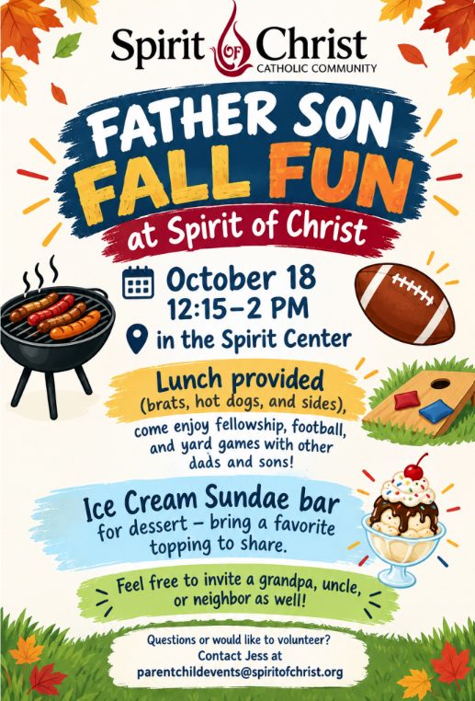
Notes:
This weekend! Father Son fall Fun!

Slide 4
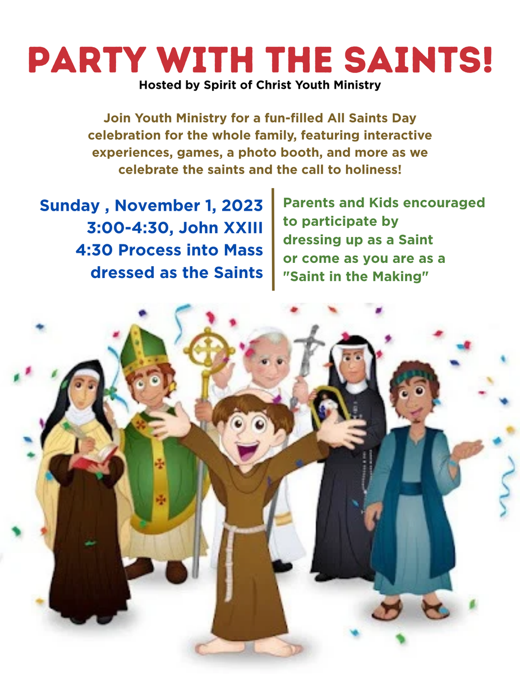


PARTY WITH THE SAINTS!
Hosted by Spirit of Christ Youth Ministry
Ignite High School Ministry and Rise Middle School Ministry present a fun-filled All Saints Day celebration for the whole family, featuring interactive experiences, games, a photo booth, and more as we celebrate the Saints and our call to holiness!
  Sunday, November 1, 2026
  3:00-4:30 pm
  In the John XXIII Room
  Kids and parents are encouraged to come dressed as a Saint! Or, come as you are, as a "Future Saint!"
Join us for a joyful procession into 4:30 Mass dressed as your favorite saint!
Notes:
As we learned last week, All Saints Day is a Holy Day of Obligation. Thankfully it is on a sunday this year so that helps but to make it even more special, our teens will be hosting A Party with the Saints.
All families are invited to come dressed as a Saints or as future saints! You can find great resources online on how to make a saint costume with just t-shirts. We will link them in a flocknote this weekend.
Come join us in celebrating this day.

Slide 5


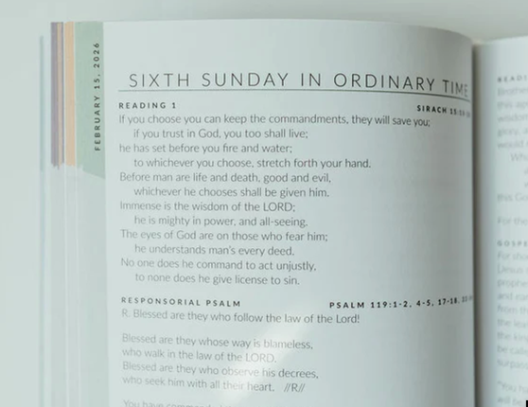
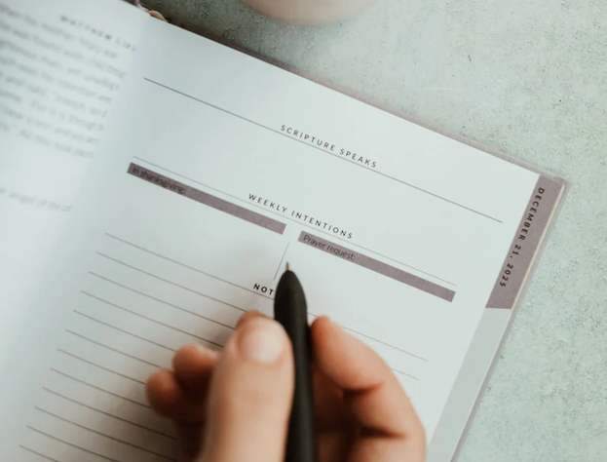
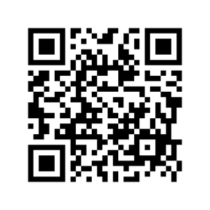

2027 Every Sacred Sunday Mass Journal
*GROUP ORDER*
Group order form closes October 16th
  Every Sacred Sunday Mass Journal – includes all Sunday readings for the year, reflection space, and seasonal prompts
  Order Deadline: October 16, 2026
  Group Discount Price: $38 each (typically $50)
  Payment Options: Venmo or Cash
(Not affiliated with Spirit of Christ)
Notes:
Last Chance to order Every Sacred Sunday Mass Journal. Scan the QR code to order.

Slide 6
Questions that arise over the year will be collected for Grill the Priest
Be mindful after Anchor sessions
Hall Monitors needed-grandparents preferred!
Charting Your Course- SPY 1 & SPY 2- more information to come soon
Table leaders- check your email for information
Announcements
Notes:
Questions Throughout the Year
As questions come up during the year, write them down or send them our way. We’ll collect them for our “Grill the Priest” opportunity.
A Quick Safety Reminder for Anchor Families
As the evenings get cooler, we want to share a gentle reminder to please be mindful of your children as you leave Anchor each week. We have had a few visitors to the parish grounds in the evenings who appear to be seeking shelter near the Prayer Garden.
While we want to continue treating everyone with compassion and dignity, we also want to be mindful of the safety of our families. Please keep your children close as you walk to your vehicles and avoid allowing them to wander the grounds unattended after sessions. Our Hall monitors have been very integral about ensuring the safety of our children during the anchor sessions.
Thank you for helping us keep Anchor a welcoming and safe environment for everyone. We appreciate your care, awareness, and continued support of our parish community!
Charting Your Course
We’ll be sending out the Charting Your Course meeting schedule soon for both SPY 1 and SPY 2 families.
These meetings are an opportunity to check in on your family’s journey, ask questions, and connect with members of our team.
Watch for more information about scheduling and what to expect.
Table Leaders
Table Leader, have been selected! Thank you for your commitment to journeying with the families at your tables.

Slide 7

Notes:
We are teetering on the edge between these two units- Basics of the Faith and Beyond the Basics.

Slide 8

Notes:
Tonight’s session will be more Beyond the Basics so as we conclude the Basics of the Faith Unit, I hope that you have encountered the faith in a deeper way.

Slide 9
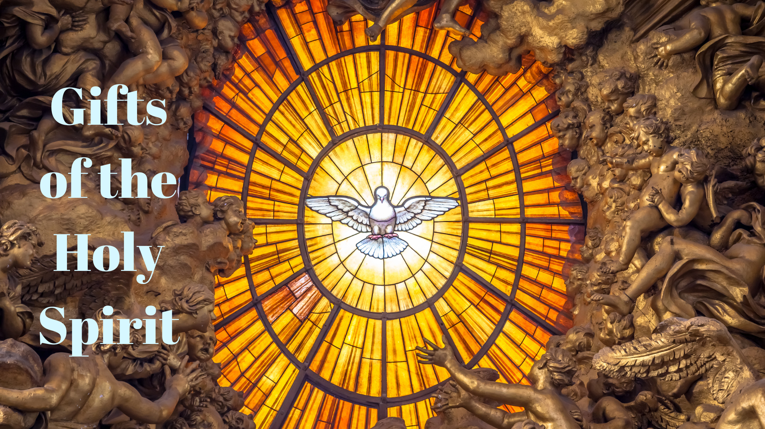

Slide 10


Slide 11
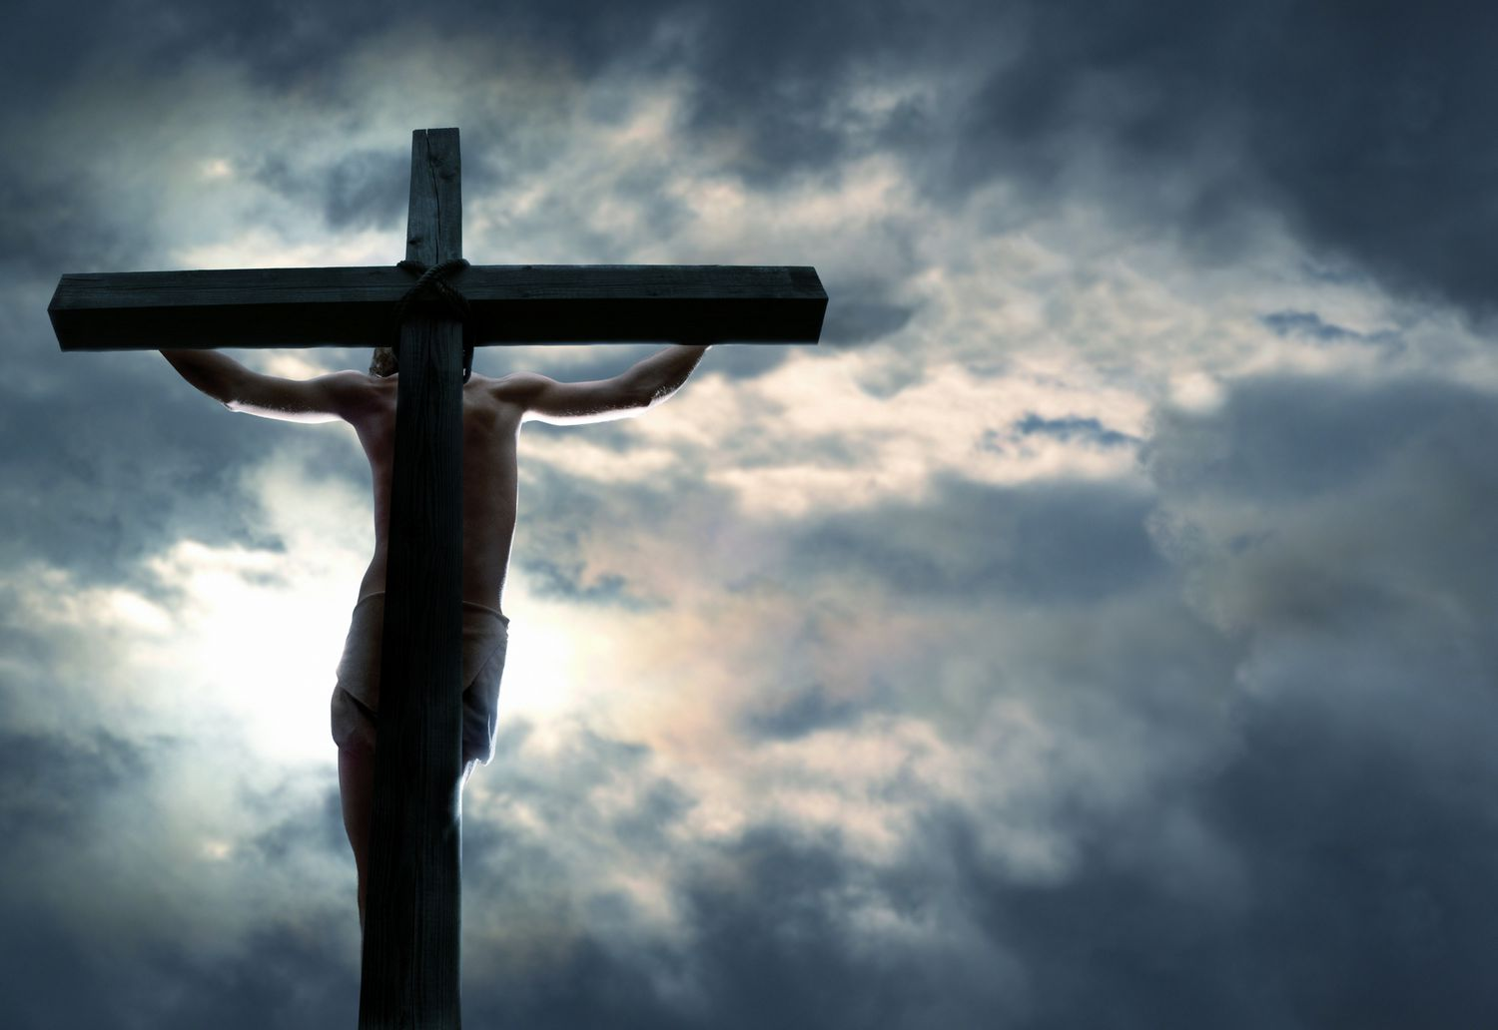
Notes:
Spend a few moments in silence to shed the worries that preoccupy our minds in order to prepare our hearts for the message of the evening.
Heavenly Father,
Thank You for Your endless love
and for the gift of Your Son, Jesus Christ.
Thank You for the gift of the Eucharist,
where we receive Jesus and are drawn closer to You.
Help us to remain close to You
and to abide in Your love.
Teach us to see the church’s precepts
not as burdens, but as a path that leads us closer to You.
Give us hearts filled with gratitude,
the courage to choose what is good,
and the grace to love others as You have loved us.
When we struggle, remind us that we do not walk alone.
May Your grace strengthen us,
Your Word guide us,
and the gift of the Eucharist nourish us
to live as faithful disciples of Your Son.
May our words, our choices, and our actions
reflect Your love and bring thanksgiving to You,
so that others may come to know You.
Amen.

Slide 12
“Take, Lord, and receive all my liberty, my memory, my understanding, and my entire will,
All I have and call my own.
You have given all to me.
To you, Lord, I return it.
Everything is yours; do with it what you will.
Give me only your love and your grace, that is enough for me.”
Short prayer of total surrender to God written by
St. Ignatius of Loyola
Let us Pray:

Slide 13
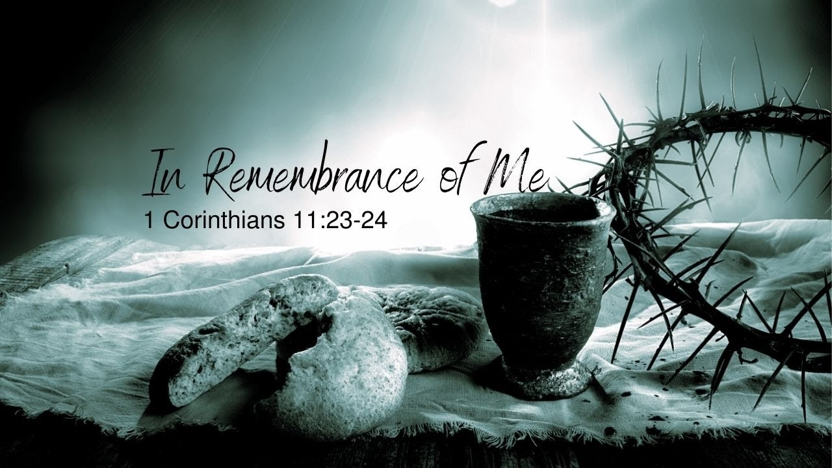
“Do this in memory of Me”
(Luke 22:19, 1 Corinthians 11:24)
Notes:
***Read the St Justin text before the parts of the Mass to see if the parents know when it was written.***
The Greek word translated as “memory” is anamnesis, which in Catholic theology means more than recalling a past event—it signifies making the past event present and real. Through anamnesis, the sacrifice of Christ on the cross becomes accessible to believers in the present moment, allowing them to participate in His redemptive act across time and space.

Slide 14
“Do this in memory of Me”
Luke 22:19, 1 Corinthians 11:24
Introductory Rites
Entrance / Procession
Greeting
Penitential Act - may include Confiteor or sprinkling rite
Kyrie- “Lord, have mercy”
Gloria- Sundays and solemnities
Collect- Opening Prayer
Notes:
Read St Justin

Slide 15
“Do this in memory of Me”
Luke 22:19, 1 Corinthians 11:24
Liturgy of the Word
First Reading- usually Old Testament
Responsorial Psalm
Second Reading- Sundays and solemnities
Gospel Acclamation -Alleluia or Lenten acclamation
Gospel and Homily
Profession of Faith- Nicene Creed on Sundays/solemnities
Universal Prayer- Prayers of the Faithful
Notes:
The Word of God is alive and active Hebrews 4:12 (...Indeed, the word of God is living and effective)

Slide 16
“Do this in memory of Me”
Luke 22:19, 1 Corinthians 11:24
Liturgy of the Eucharist
Presentation of the Gifts/Preparation of the Altar
Prayer over the Offerings
Eucharistic Prayer, including:
Preface
Sanctus -“Holy, Holy, Holy”
Epiclesis
Consecration
Anamnesis
Doxology
Notes:
The Greek word translated as “memory” is anamnesis, which in Catholic theology means more than recalling a past event—it signifies making the past event present and real. Through anamnesis, the sacrifice of Christ on the cross becomes accessible to believers in the present moment, allowing them to participate in His redemptive act across time and space

Slide 17
“Do this in memory of Me”
Luke 22:19, 1 Corinthians 11:24
Liturgy of the Eucharist
The Lord’s Prayer
Sign of Peace
Lamb of God
Communion
Prayer after Communion
Concluding Rites
Announcements (optional)
Blessing
Dismissal/Commission- “Go in peace”

Slide 18
Living the “Mass” before and after
Preparing as parents and as a family… (Reconciliation)
Who am I (we) going to meet?
The Eucharist is called the source of the Christian life because it makes present the one redemptive sacrifice of Jesus Christ on Calvary.
The Eucharist is also the summit of the Christian life because it represents the highest form of communion with God.
Heavenly Banquet, a foretaste of Heaven
“Do this in memory of Me”
Luke 22:19, 1 Corinthians 11:24
Notes:
Through the Eucharist, catholics encounter Christ, participate in His sacrifice, and are drawn into deeper communion with God and the Church, making it the central mystery of Catholic life and spirituality.
εὐχᾰ́ρῐστος (eukhắrĭstos, “thankful, grateful”)

Slide 19
What are some family celebrations that I cherished as a child? Why?
Eucharist: How can I as a parent grow in the habit of Thankfulness and Gratitude?
What are some ways we can prepare to meet Him (Jesus) at Mass?
What can we do as a family to live out the commision/Dismissal in our deeds?
Discussion Questions

Slide 20
Helpful Resources
https://katiewarner.com/downloads/parish-resources/10-Mass-Tips-for-Catholic-Families.pdf
https://holyheroes.com/pages/sunday-mass-prep
https://www.catholicmom.com/sunday-mass-activities
https://www.catholicfamilyfaith.org/masssunday-worship--lectionary-resources.html
Remember that the most important resource is regular Family Prayer
Resources

Slide 21
